Slide 1
Stroke & Vision Loss
Insert Group Name
or Logo Here
In partnership with:

Slide 2
Vision Deficits After Stroke Are Very Common
On average, someone in the U.S. has a stroke every 40 seconds.
About 610,000 of these are first or new strokes. About 185,00 strokes—nearly one of four—are in people who have had a previous stroke.
About 87% of all strokes are ischemic strokes, when blood flow to the brain is blocked.
Although stroke risk increases with age, strokes can—and do—occur at any age, 34% of people hospitalized for stroke are younger than 65 years.*
According to stroke.org, up to 66% of people who suffer from a stroke experience changes to their vision. 20% experience a permanent Visual Field Deficit.

Slide 3
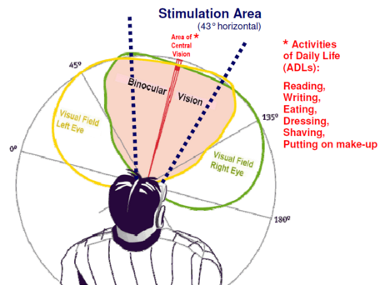
What Causes Vision Deficits After Stroke?
Damage caused to specific regions of the visual cortex or its connecting neural network.
Typically, the loss of vision is due to damage that has been done to that part of the brain that processes visual information which is transmitted to it using one's eyes as the conduits.

Slide 4
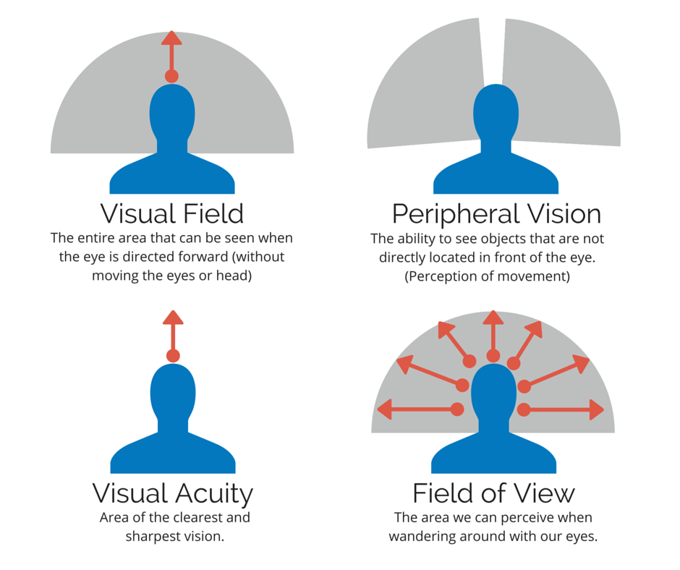
Vision Impacted After A Stroke

Slide 5
Types Of Post-Stroke Vision Deficits
Hemianopia
Stroke victims with Hemianopia experience blindness in one half of their visual field.
If you have suffered from a stroke that occurred in the left hemisphere of your brain, your ability to see properly in the right visual field of each eye may be negatively affected. On the other hand, if you have suffered a stroke in the right hemisphere of your brain, the left visual field of each eye may be affected.

Slide 6
Types of Post-Stroke Vision Deficits
Quadrantanopia
This is similar to hemianopia but the loss of vision occurs in a quarter of your visual field, as opposed to half.

Slide 7
Types of Post-Stroke Vision Deficits
Scotoma
This condition refers to spotty vision or smaller area of blindness than hemianopia or quadrantanopia.

Slide 8
Types of Post-Stroke Vision Deficits
Tunnel Vision
This condition is fairly self explanatory, referring to a loss of peripheral vision that mimics looking through a tunnel.

Slide 9
3 Recovery Options
Vision Restoration
Vision Compensation
Substitution

Slide 10
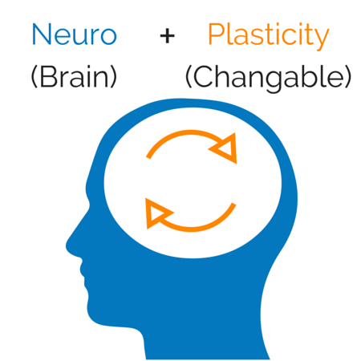
The Concept of Neuroplasticity
Your brain’s natural ability to compensate for injuries and adjust to deal with these changes by creating new neural pathways and adapting as needed.
Some networks in the brain are duplicated and Neuroplasticity enables the activation and usage of alternative routes to process information.
Researchers studying in brain based healing methods have discovered that changes benefiting one person may be detrimental to another, therefore the brain training apps promising benefits to all may not indeed be effective for all. It is imperative that any neuroplasticity treatment must be tailored and monitored to fit each patient.
(Changeable)

Slide 11
Recovery Options: Vision Restoration
Vision Restoration Therapy (VRT)
VRT is the only FDA cleared restoration therapy for the treatment of vision loss as a result of stroke or other brain injury, and is designed to provide actual improvement in the range or sensitivity of the patient’s field of vision.
VRT is clinically supported by years of research and studies, including a 302 patient study in which notable improvements were seen in over 70% of the patients.
VRT requires a prescription from a physician.
Therapy is personalized for the vision deficit and updated monthly.
Therapy can be done at home on a computer. No surgery or other medical intervention is needed.
Improvement does not depend on how long ago their vision loss occurred (Efficacy is independent of lesion age).
Pre VRT
Post VRT

Slide 12
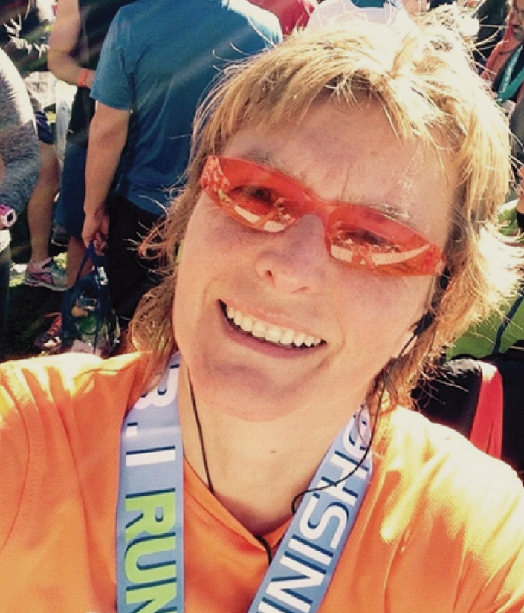
Vision Restoration Therapy Patient Testimonial
“I could not be independent anymore. I could not be myself, not being able to drive took my life away.
With VRT my visual field improved to a 90%. I was able to publish a book and run 2 marathons! This would have been impossible without my vision recovery.”
Visit us at http://www.novavision.com/vrt-patient-testimonials/ for additional patient testimonials

Slide 13
Recovery Options: Vision Compensation
NeuroEyeCoach
Using saccadic training, patients are trained to rapidly and continuously scan their surroundings in order to direct their gaze toward the blind field, bringing the previously unseen objects within their sighted field.
Designed to have a real positive impact on activities of daily living and is FDA registered.
Leads to meaningful improvement in visual search performance, resulting in improvements in navigation skills and object finding.
Increases the efficiency of a patient’s eye movement and re-train the patient’s ability to make the most of their remaining vision.
Can be performed either in a center under physician supervision or at home.
Treatment Duration: as quick as 2-4 weeks.
before training
(small eye shifts, many
fixations; longer scanning
time)
after training
(larger eye shifts, less fixations, shorter
scanning time)
Dots: fixations, lines: eye shifts

Slide 14
NeuroEyeCoach Patient Testimonial
“I feel more confident and safe with my improved ability to see more while also having a heightened awareness of my surroundings. I can’t put a value on what I have gained with NeuroEyeCoach, I can just say Thank You with all that I am.”
Luree - Virginia
Visit us at http://www.novavision.com/neuroeyecoach-testimonials/ for additional patient testimonials

Slide 15
Recovery Options: Substitution
Through the use of optical aids.
Goal: Extension of sighted field towards the blind field.
Coping strategy → This does not increase sensitivity in the blind field but rather uses prisms to optically shift part of the visual space.
While there may be an initial improvement (typically <10° (Giorgi et al., 2009), over time, the results often deteriorate. Also, many stroke patients find the use of prisms to be visually confusing and reject this coping technique.

Slide 16
Why Your Doctor Might Be Hesitant
Although therapies based on Neuroplasticity, such as Vision Restoration Therapy, are based on years of research, some doctors may be hesitant to prescribe this therapy.
Physicians may not be familiar with the clinical data supporting VRT.
Physicians may have questions relating to the therapy before writing a prescription.
Have an informed discussion with your doctor!

Slide 17
Next Steps:
Visit NovaVision’s blog and read up about Neuroplasticity & Post-Stroke Vision Loss.
Take NovaVision’s online vision test to help identify a possible deficit and facilitate an informed discussion about your vision concerns with your physician.
Visit the NovaVision website to get answers to any questions you might have.
Talk to your doctor.
Or find a Prescribing Physician from NovaVision’s online physician directory.

Slide 18
Any Questions?

